Slide 1
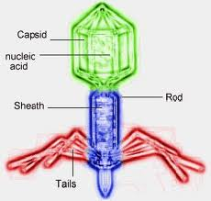
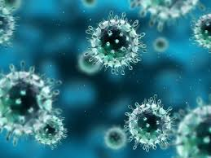
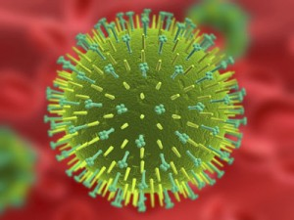
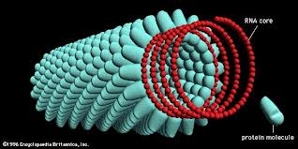
VIRUSES
Bacteriophage
Adenovirus
Influenza virus
Tobacco mosaic virus

Slide 2

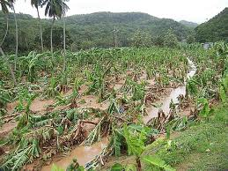
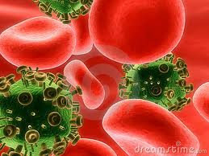
Why are they bad?
Infects plants and destroys farmer’s crops
Infects animals and humans and cause many diseases through the lytic cycle. Eg. SARS , influenza, chicken pos, common cold
Symptoms are produced by destruction of cells and tissues
Can hide in the DNA of an organism (lysogenic cycle) and can be transmitted to another person unknowingly. Eg. HIV, hepatitis
Have the ability to mutate and change their outer appearance, making them difficult to treat.

Slide 3

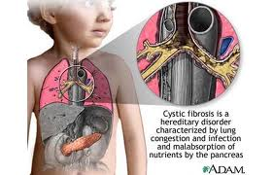
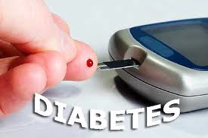
WHY ARE THEY GOOD?
They are smaller than a living cell, so viruses can be used as vectors to carry good genes into diseased cells. This is called gene therapy and is a method used to treat some genetic disorders such as diabetes and cystic fibrosis.

Slide 4
Steps involved
1) Virus genetic material is removed and replaced with normal DNA
2) Virus is administered to target cells. This can be done through different means such as inhalers to target respiratory cells.
3) Virus injects the normal DNA into the host or target cell.
4) Gene carrying the normal DNA is incorporated into the host cell genome.
5) Diseased cell begins to express the new DNA, which restores the cell’s intended function and eliminates the symptoms of the disease.

Slide 5
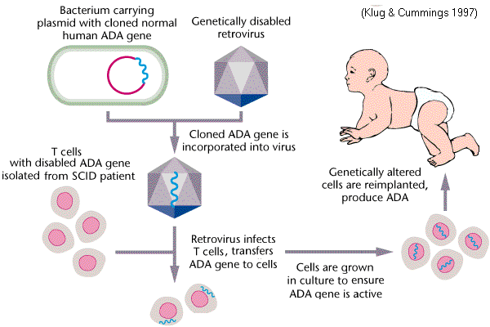
Gene therapy

Slide 6
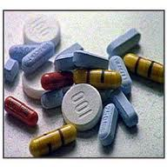
TREATMENT
Most viral diseases cannot be cured. Modern antibiotics are NOT effective against viruses.
Only symptoms of the infection can be treated eg/ fever medication, restore fluid loss, etc
Antiviral medications are used to prevent the virus from replicating; NOT effective against all viruses and NOT useful once virus mutates.

Slide 7
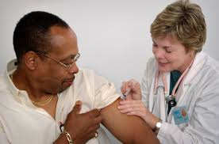
PREVENTION
Vaccinations – injections of dead or weakened virus particles which stimulate the body’s immune system to produce antibodies
These antibodies circulate in the blood stream and act as memory cells to kill the virus if it ever invades the body in the future.
Proper hygiene and hand washing practices
Stay home of you are sick to limit the spread of the infection.

